Slide 1

SQL & PYTHON ANALYTICS
Customer Shopping Behavior Analysis
Source Dataset
customer_shopping_behavior.csv
insights
A rigorous business intelligence audit of 3,900 rows inside customer_shopping_behavior.csv mapped to structured MySQL pipelines.
Target Database
MySQL Data Warehouse

Slide 2

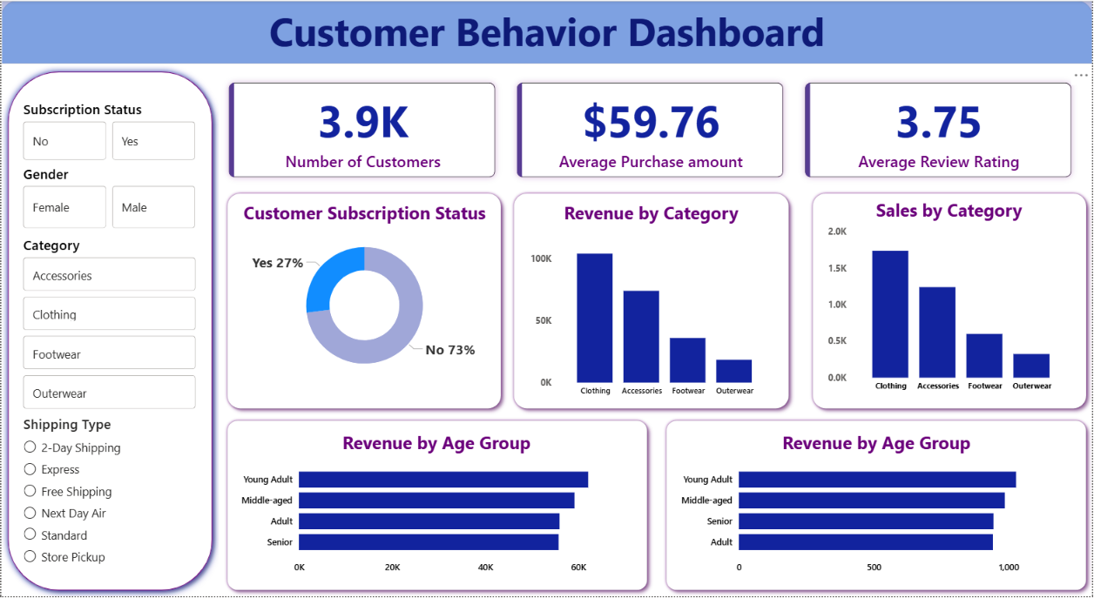
Data Engineering Pipeline
Prior to conducting business intelligence queries, the source pipeline underwent deep preprocessing and schema matching using Python (pandas):
Null Imputation: Replaced 37 missing review_rating values with group-wise category medians.
Feature Engineering: Generated age_group (via pd.qcut) & normalized purchase_frequency_days mapping.
Redundancy Removal: Dropped promo_code_used after verifying a 100% logical duplicate of discount_applied.
SQL Integration: Loaded all records into MySQL (customer_behavior database) via SQLAlchemy connection.

Slide 3
01 / Customer Segments
Profiling demographic attributes, transactional volumes, and retention traits within our purchaser ecosystem.

Slide 4
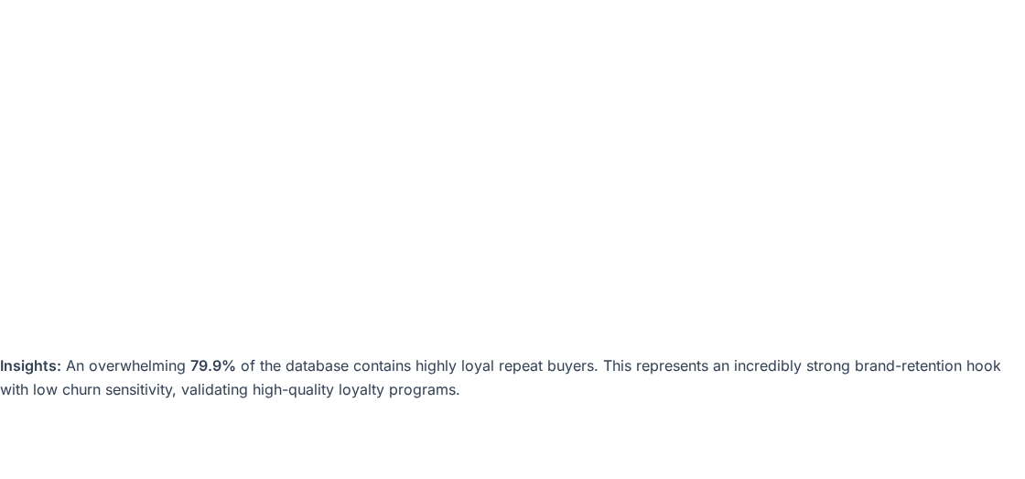
Customer Lifecycle Segmentation
Customer Segment | Definition (Previous Purchases) | Customer Count | % of Database | Strategic Action Item
New Customers | Exactly 1 purchase | 80 | 2.05% | Automate high-priority 2nd order acquisition flows.
Returning Customers | Between 2 and 10 purchases | 704 | 18.05% | Target with product bundles and localized category cross-sells.
Loyal Customers | Greater than 10 purchases | 3,116 | 79.90% | Enroll in VIP tiers; maximize lifetime value via subscriptions.

Slide 5
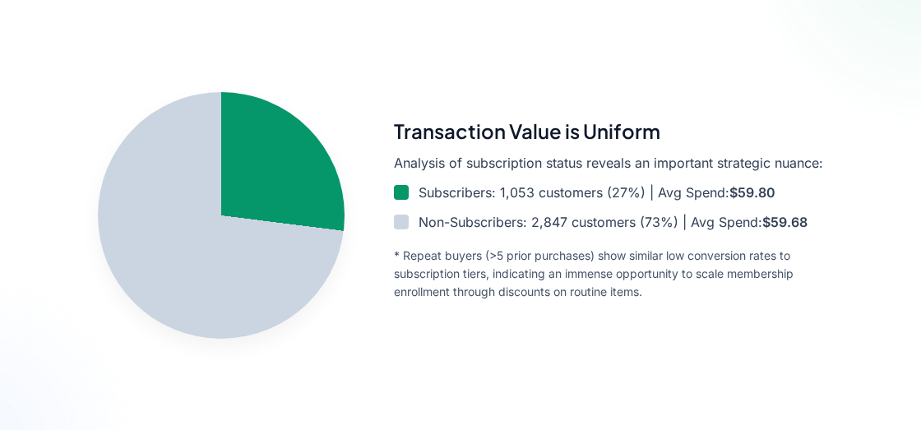
Subscribers vs Non-Subscribers

Slide 6
Gender Revenue Contribution
Volume-Driven Market Dominance
A closer look at transactional breakdown shows gender divergence is driven by demographic volume rather than average basket value:
$157,890
Female Total Revenue: Generates $75,191 (32.3% share).
Average Basket Equilibrium: Average purchase value remains constant at $59.76 regardless of gender selection.
Male Total Revenue (67.7%)
Action Item: Target women-centric marketing acquisition campaigns to correct database skew, as female conversion yields identical structural basket sizes.

Slide 7
02 / Product & Pricing
Investigating regional purchasing, seasonal trends, category benchmarks, and promotion performance.

Slide 8
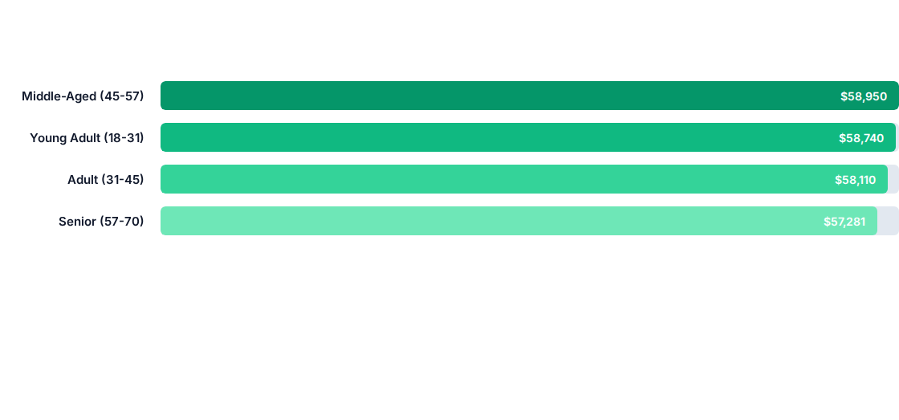
Revenue by Generational Age Group
Since we implemented quartile-based grouping (pd.qcut) during engineering, the revenue distribution across age bands is remarkably uniform, hovering around $57,000 to $59,000 per segment. Marketing programs should remain age-agnostic or utilize broad behavioral targeting over strict generational segmentation.

Slide 9

Category Performance leaders
Clothing Dominates Transaction Share
Out of 3,900 observations, Clothing continues to hold the largest transactional volume with 1,737 total orders.
Clothing: Led by Pants, Blouses, and Sweaters.
Accessories: Powered by Jewelry, Backpacks, and Belts.
Footwear: Led by Shoes, Sandals, and Sneakers.

Slide 10
Shipping & Promotion Insights
Shipping Value Equivalence (Q4): Standard shipping average order value ($59.54) has statistical parity with Express shipping ($59.78). This confirms express logistics options can be offered freely without risk of lowering user purchase bounds.
Quality Satisfaction Anchors (Q3): Under top ratings, items like Jackets, Jewelry, and Sweaters consistently lead the database with an average score of over 3.80, making them highly reliable choices for customer acquisition strategies.
Promo-Sensitive Item Drivers (Q6): Promotions and discount application rates peak strongly on daily staples (Blouses and Sweaters), showing conversion rates around 43%. Utilize these items selectively as margin leaders.

Slide 11
Questions & Answers
Customer Shopping Behavior Data Analytics Presentation
Refer to customer_shopping_behavior.csv for all raw data points.
Analysis performed with Python 3.14 & SQL MySQL engine wrapper.

